Slide 2

Indexing NuGet.org with Azure Functions
Maarten Balliauw @maartenballiauw

Slide 3
Abstract
Indexing and searching NuGet.org with Azure Functions and Search
Which NuGet package was that type in again? In this session, let's build a "reverse package search" that helps finding the correct NuGet package based on a public type.
Together, we will create a highly-scalable serverless search engine using Azure Functions and Azure Search that performs 3 tasks: listening for new packages on NuGet.org (using a custom binding), indexing packages in a distributed way, and exposing an API that accepts queries and gives our clients the best result.

Slide 4
“Find this type on NuGet.org”

Slide 5
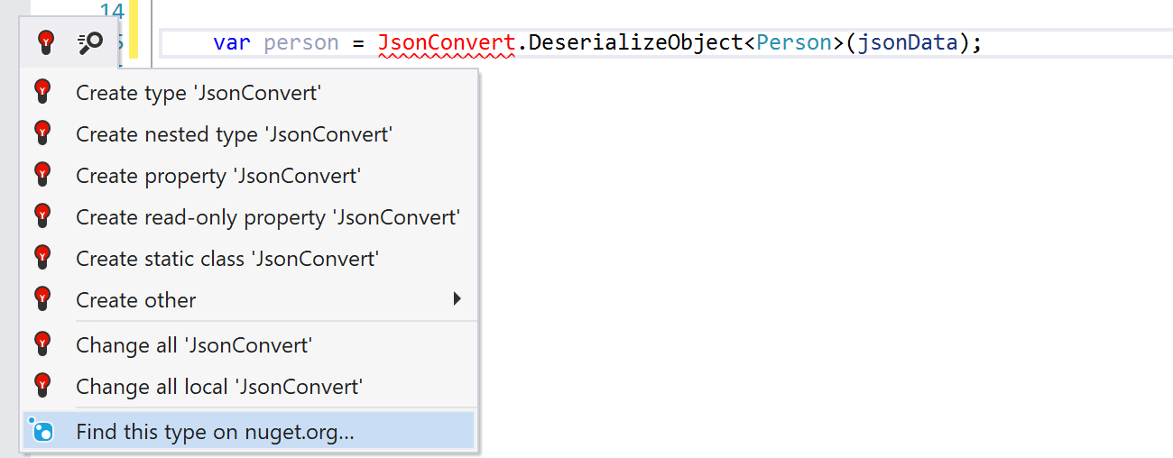


“Find this type on NuGet.org”
In ReSharper and Rider
Search for namespaces & types that are not yet referenced
Notes:
Show feature in action in Visual Studio (and show you can see basic metadata etc.)

Slide 6
“Find this type on NuGet.org”
Introduced in ReSharper 9 (2015 - https://www.jetbrains.com/resharper/whatsnew/whatsnew_9.html)
Consists of
ReSharper functionality
A service that indexes packages and powers search
Azure Cloud Service (Web and Worker role)
Indexer uses NuGet OData feed
https://www.nuget.org/api/v2/Packages?$select=Id,Version,NormalizedVersion,LastEdited,Published&$orderby=LastEdited%20desc&$filter=LastEdited%20gt%20datetime%272012-01-01%27
Notes:
Copied in 2017 in VS - https://www.hanselman.com/blog/VisualStudio2017CanAutomaticallyRecommendNuGetPackagesForUnknownTypes.aspx
Demo the feed quickly?

Slide 7
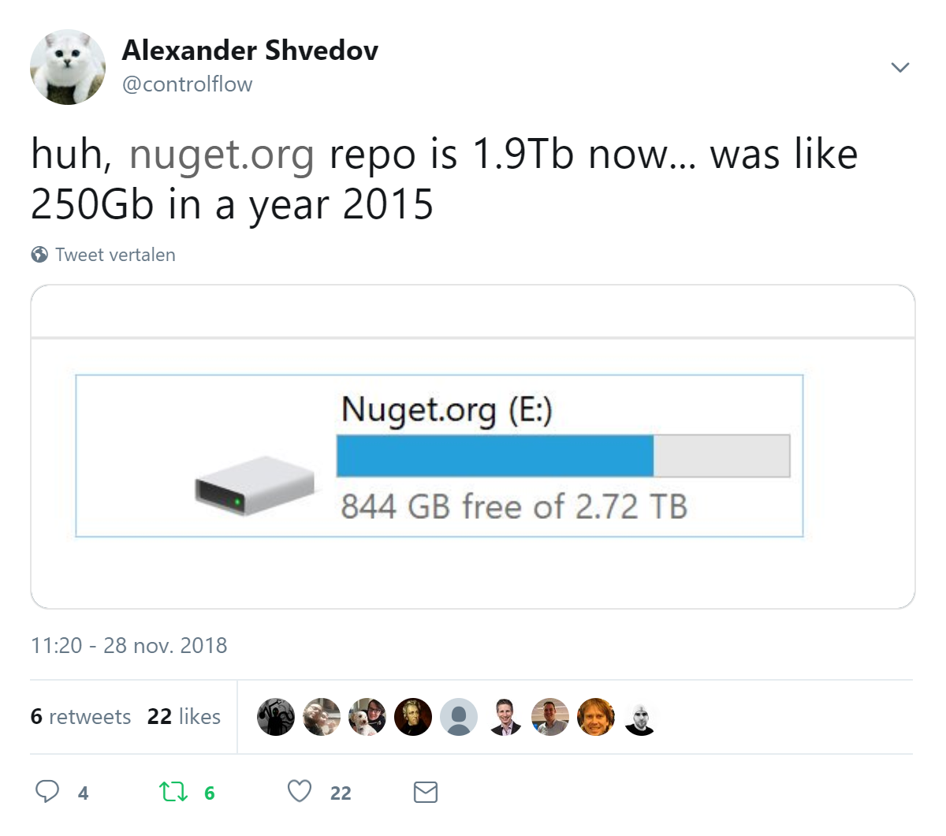
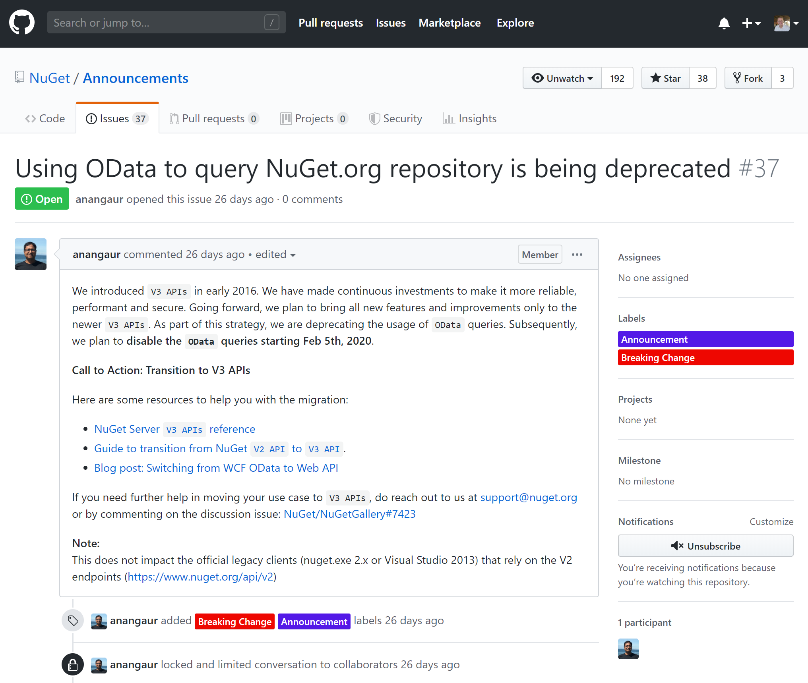
NuGet over time...
https://twitter.com/controlflow/status/1067724815958777856
https://github.com/NuGet/Announcements/issues/37
Notes:
More and more packages
OData feed slow to query & scheduled for deprecation
Is there a better way?

Slide 8
NuGet server-side API

Slide 9
V3 Protocol
JSON based
A “resource provider” of various endpoints per purpose
Search
Autocomplete
Package restore
Catalog (NuGet.org only) – append-only event log
…
https://api.nuget.org/v3/index.json (code in https://github.com/NuGet/NuGet.Services.Metadata)
Notes:
Demo: click around in the API to show some base things

Slide 10
Catalog seems interesting!
Append-only stream of mutations on NuGet.org
Updates (add/update) and Deletes
Chronological
Can continue where left off (uses a timestamp cursor)
Can restore NuGet.org to a given point in time
Structure
Root https://api.nuget.org/v3/catalog0/index.json
+ Page https://api.nuget.org/v3/catalog0/page0.json
+ Leaf https://api.nuget.org/v3/catalog0/data/2015.02.01.06.22.45/adam.jsgenerator.1.1.0.json

Slide 11

NuGet.org catalog
demo
Notes:
Raw API - click around in the API to show some base things, explain how a cursor could go over it
Root https://api.nuget.org/v3/catalog0/index.json
Page https://api.nuget.org/v3/catalog0/page0.json
Leaf https://api.nuget.org/v3/catalog0/data/2015.02.01.06.22.45/adam.jsgenerator.1.1.0.json
Explain CatalogDump
NuGet.Protocol.Catalog comes from GitHub
CatalogProcessor feches all pages between min and max timestamp
My implementation BatchCatalogProcessor fetches multiple pages at the same time and build a “latest state” – much faster!
Fetches leaves, for every leaf calls into a simple method
Much faster, easy to pause (keep track of min/max timestamp)

Slide 12
“Find this type on NuGet.org”
Refactor from using OData to using V3?
Mostly done, one thing missing: download counts (using search now)
https://github.com/NuGet/NuGetGallery/issues/3532
Build a new version?
Welcome to this talk ☺

Slide 13
Building a new version

Slide 14
What do we need?
Watch the NuGet.org catalog for package changes
For every package change
Scan all assemblies
Store relation between package id+version and namespace+type
API compatible with all ReSharper and Rider versions

Slide 15
What do we need?
Watch the NuGet.org catalog for package changes periodic check
For every package change based on a queue
Scan all assemblies
Store relation between package id+version and namespace+type
API compatible with all ReSharper and Rider versions always up, flexible scale

Slide 16






Sounds like Azure functions!
Find type API
Search index
Index command
Index package
Find namespace API
Index as JSON
NuGet.org catalog
Watch catalog
Download command
Download package
Raw .nupkg
Notes:
Will use storage queues n demo’s to be able to run things locally. Ideally use SB topics or event grid (transactional)

Slide 17
Collecting from catalog
demo
Notes:
Create a new TimerTrigger function
We will need a function to index things from NuGet
Timer will trigger every X amount of time
Timer provides last timestamp and next timestamp, so we can run our collector for that period
Snippet: demo-timertrigger
Mention HttpClient not used correctly: not disposed, so will starve TCP connections at some point
Go over code example and run it
var httpClient = new HttpClient();
var cursor = new InMemoryCursor(timer.ScheduleStatus?.Last ?? DateTimeOffset.UtcNow);
var processor = new CatalogProcessor(
cursor,
new CatalogClient(httpClient, new NullLogger<CatalogClient>()),
new DelegatingCatalogLeafProcessor(
added =>
{
log.LogInformation("[ADDED] " + added.PackageId + "@" + added.PackageVersion);
return Task.FromResult(true);
},
deleted =>
{
log.LogInformation("[DELETED] " + deleted.PackageId + "@" + deleted.PackageVersion);
return Task.FromResult(true);
}),
new CatalogProcessorSettings
{
MinCommitTimestamp = timer.ScheduleStatus?.Last ?? DateTimeOffset.UtcNow,
MaxCommitTimestamp = timer.ScheduleStatus?.Next ?? DateTimeOffset.UtcNow,
ServiceIndexUrl = "https://api.nuget.org/v3/index.json"
},
new NullLogger<CatalogProcessor>());
await processor.ProcessAsync(CancellationToken.None);

Slide 18
Functions best practices
@PaulDJohnston https://medium.com/@PaulDJohnston/serverless-best-practices-b3c97d551535
Each function should do only one thing
Easier error handling & scaling
Learn to use messages and queues
Asynchronous means of communicating, helps scale and avoid direct coupling
...
Notes:
Each function should only do one thing! We are violating this.

Slide 19
Bindings
 | Trigger | Input | Output
Timer | ✔
HTTP | ✔ |  | ✔
Blob | ✔ | ✔ | ✔
Queue | ✔ |  | ✔
Table |  | ✔ | ✔
Service Bus | ✔ |  | ✔
EventHub | ✔ |  | ✔
EventGrid | ✔
CosmosDB | ✔ | ✔ | ✔
IoT Hub | ✔
SendGrid, Twilio |  |  | ✔
... |  |  | ✔
Help a function do only one thing
Trigger, provide input/output
Function code bridges those
Build your own!*
SQL Server binding
Dropbox binding
...
NuGet Catalog
*Custom triggers not officially supported (yet?)
Notes:
https://github.com/thinktecture/azure-functions-extensibility

Slide 20
Creating a trigger binding
demo
Notes:
Go over Approach2 code
Show this is MUCH simpler – trigger binding that provides input, queue output bindign to write that input to a queue
Let’s go over what it takes to build a trigger binding
NuGetCatalogTriggerAttribute – the data needed for the trigger to work – go over properties and attributes
Hooking it up requires a binding configuration – NuGetCatalogTriggerExtensionConfigProvider
It says: if you see this specific binding, register it as a trigger that maps to some provider
So we need that provider – NuGetCatalogTriggerAttributeBindingProvider
Provider is there to create an object that provides data. In our case we need to store the NuGet catalog timestamp cursor, so we do that on storage, and then return the actual binding – NuGetCatalogTriggerBinding
In NuGetCatalogTriggerBinding, we have to specify how data can be bound. What if I use a differnt type of object than PackageOperation? What if someone used a node.js or Python function instead of .NET. Need to define the shape of the data our trigger provides.
PackageOperationValueProvider is also interesting, this provides data shown in the portal diagnostics
CreateListenerAsync is where the actual triger code will be created – NuGetCatalogListener
NuGetCatalogListener uses the BatchCatalogProcessor we had previously, and when a package is added or deleted it will call into the injected ITriggeredFunctionExecutor
ITriggeredFunctionExecutor is Azure Functions framework specific, but it’s the glue that will clal into our function with the data we provide
Note StartAsync/StopAsync where you can add startup/shutdown code
ONE THING LEFT THAT IS NOT DOCUMENTED – Startup.cs to register the binding.
And since we are in a different class library, also need Microsoft.Azure.WebJobs.Extensions referenced to generate \bin\Debug\netcoreapp2.1\bin\extensions.json
As a result our code is now MUCH cleaner, show it again and maybe also show it in action
Mention [Singleton(Mode = SingletonMode.Listener)] – we need to ensure this binding only runs single-instance (cursor clashes otherwise). This is due to ho the catalog works, parallel processing is harder to do. But we can fix that by scaling the Indexer later on.
Show Approach3 PopulateQueueAndTable
Same code, but a bit more production worthy
Sending data to two queues (indexing and downloading)
Storing data in a table (and yes, violating “do one thing” again but I call it architectural freedom)

Slide 21
Indexing
Download .nupkg and open (it’s a ZIP file)
Reflecting on assemblies
System.Reflection.Metadata
Access Portable Executable (PE) metadata in assembly without loading into process
Store relation between package id+version and namespace+type
Azure Search

Slide 22
Indexing packages
demo
Notes:
Go over Approach3 code
PackageIndexerWithCustomBinding is mostly the same code
One difference: it uses the [AzureSearchIndex] binding to write add/delete operations to the index instead
Go over how it works. Again, an attribute with settings – AzureSearchIndexAttribute
Also a configuration that registers the binding as an output binding using BindToCollector – AzureSearchExtensionConfigProvider
Now, what’s this OpenType?
It’s some sort of dynamic type. If we want to create an AzureSearch output binding, we better support more than just our PackageDocument use case!
So we need a collector builder that can create the actual binding implementation based on the real type requested by our function parameter – AzureSearchAsyncCollectorBuilder
In AzureSearchAsyncCollectorBuilder, we do that. Very simple bootstrap code in this case, but could be more complex depending on the type of binding you are creating.
Our AzureSearchAsyncCollector uses the attribute to check for Azure Search connection details, as well as the type of operation we expect it to handle. Why not all? Well, IAsyncCollector only has Add and Flush.
Note: add called manually, flush at function complete – could use flush to send things in a batch...
Code itself pretty straightforward. On Add, we add an action to search. With a retry in case the index does not exist – we then create it.
Creation code kind of interesting as we use some reflection in case we specify a given type of coument to index.
Why? Cause when we do Upserts, we may want to update just one or two properties, and can use a different Dto in that case (but still have the index shaped to the full document shape)
Run when time left, but nothing fancy here...

Slide 23
Next steps…
✓ Watch the NuGet.org catalog for package changes
✓ For every package change
Scan all assemblies
Store relation between package id+version and namespace+type
API compatible with all ReSharper and Rider versions
Blog post with full story and implementation https://bit.ly/2lzba32
👀

Slide 24
Making search work with ReSharper and Rider
demo
Notes:
Go over Web code
RunFindTypeApiAsync and RunFindNamespaceAsync
Both use “name” as their query parameter to search for
RunInternalAsync does the heavy lifting
Grabs other parameters
Runs search, and collects several pages of results
Why is this ForEachAsync there?
Search index has multiple versions for every package id, yet ReSharper expects only the latest matching all parameters
Azure Search has no group by / distinct by, so need to do this in memory. Doing it here by fetching a maximum number of results and doing the grouping manually.
Use the collected data to build result. Add matching type names etc.
Example requests:
http://localhost:7071/api/v1/find-type?name=JsonConvert
http://localhost:7071/api/v1/find-type?name=CamoServer&allowPrerelease=true&latestVersion=false
https://nugettypesearch.azurewebsites.net/api/v1/find-type?name=JsonConvert
In ReSharper (devenv /ReSharper.Internal, go to NuGet tool window, set base URL to https://nugettypesearch.azurewebsites.net/api/v1/)
Write some code that uses JsonConvert / JObject and try it out.

Slide 25
Learnings
Find type API
Search index
Index command
Index package
Find namespace API
Index as JSON
NuGet.org catalog
Watch catalog
Download command
Download package
Raw .nupkg

Slide 26
Learnings
Functions
Collect changes from NuGet catalog
Download binaries
Index binaries using PE Header
Make search index available in API
Trigger, input and output bindings
Each function should do only one thing
Find type API
Search index
Index command
Index package
Find namespace API
Index as JSON
NuGet.org catalog
Watch catalog
Download command
Download package
Raw .nupkg

Slide 27
Learnings
All our functions can scale (and fail) independently
Full index in May 2019 took ~12h on 2 B1 instances
Can be faster on more CPU’s
~ 2.1mio unique packages in the catalog
~ 8 400 catalog pages
with ~ 4 200 000 catalog leaves
Find type API
Search index
Index command
Index package
Find namespace API
Index as JSON
NuGet.org catalog
Watch catalog
Download command
Download package
Raw .nupkg

Slide 28
Learnings
Deploy in separate function apps for cost, performance & fault boundaries
Trigger binding collects all the time – small reserved instance
Other functions on-demand – consumption plan
Bindings
Very nice programming model

Slide 29

Thank you! Full story & implementation: https://bit.ly/2lzba32
Maarten Balliauw @maartenballiauw

